Slide 1

6CCS3AIN: 2020-2021 Lecture 8A: Argumentation
Peter McBurney
(with thanks to Elizabeth Black)

Slide 2
The final 3 weeks of lectures in 6CCS3AIN
Lecture 8: Argumentation Theory (Parts A and B)
Lecture 9: Consensus Algorithms (with David Kohan Marzagão)
Lecture 10: AI and Ethics

Slide 3
This Week (Lecture 8): Argumentation Theory
Part A
Introduction
Abstract argumentation
Extension-based semantics
Part B
Complete semantics
Grounded semantics
Preferred semantics
Stable semantics
Argument acceptance

Slide 4
What is an argument?

Slide 5
What is an argument?
“A statement, reason, or fact for or against a point.” http://www.dictionary.com/browse/argument
“ A course of reasoning aimed at demonstrating truth or false-hood” https://www.thefreedictionary.com/argument
“A discussion involving differing points of view” http://www.dictionary.com/browse/argument
“An address or composition intended to convince or persuade” http://www.dictionary.com/browse/argument

Slide 6
What is an argument?
“A statement, reason, or fact for or against a point.” http://www.dictionary.com/browse/argument
“ A course of reasoning aimed at demonstrating truth or false-hood” https://www.thefreedictionary.com/argument
“A discussion involving differing points of view” http://www.dictionary.com/browse/argument
“An address or composition intended to convince or persuade” http://www.dictionary.com/browse/argument
We should go on holiday to Costa Rica because we’ll see lots of amazing animals.

Slide 7
What is an argument?
“A statement, reason, or fact for or against a point.” http://www.dictionary.com/browse/argument
“ A course of reasoning aimed at demonstrating truth or false-hood” https://www.thefreedictionary.com/argument
“A discussion involving differing points of view” http://www.dictionary.com/browse/argument
“An address or composition intended to convince or persuade” http://www.dictionary.com/browse/argument
“The evidence for a flat earth is derived from many different facets of science and philosophy. The simplest is by relying on ones own senses to discern the true nature of the world around us. The world looks flat, the bottoms of clouds are flat, the movement of the sun; these are all examples of your senses telling you that we do not live on a spherical heliocentric.” world. www.theflatearthsociety.org

Slide 8
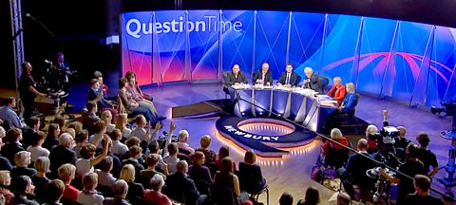
What is an argument?
“A statement, reason, or fact for or against a point.” http://www.dictionary.com/browse/argument
“ A course of reasoning aimed at demonstrating truth or false-hood” https://www.thefreedictionary.com/argument
“A discussion involving differing points of view” http://www.dictionary.com/browse/argument
“An address or composition intended to convince or persuade” http://www.dictionary.com/browse/argument
https://www.bbc.co.uk/programmes/articles/5vyK2GwYrdQGFvCJyKNfZhn/join-the-question-time-audience

Slide 9
What is an argument?
“A statement, reason, or fact for or against a point.” http://www.dictionary.com/browse/argument
“ A course of reasoning aimed at demonstrating truth or false-hood” https://www.thefreedictionary.com/argument
“A discussion involving differing points of view” http://www.dictionary.com/browse/argument
“An address or composition intended to convince or persuade” http://www.dictionary.com/browse/argument
“…I still have a dream, a dream deeply rooted in the American dream – one day this nation will rise up and live up to its creed, "We hold these truths to be self evident: that all men are created equal." I have a dream ...”
—Martin Luther King Jr. (1963)

Slide 10
What is an argument?
“A statement, reason, or fact for or against a point.” http://www.dictionary.com/browse/argument
“ A course of reasoning aimed at demonstrating truth or false-hood” https://www.thefreedictionary.com/argument
“A discussion involving differing points of view” http://www.dictionary.com/browse/argument
“An address or composition intended to convince or persuade” http://www.dictionary.com/browse/argument

Slide 11
Argumentation theory
“Argumentation is a verbal, social, and rational activity aimed at convincing a reasonable critic of the acceptability of a standpoint by putting forward a constellation of propositions justifying or refuting the proposition expressed in the standpoint.”
Van Eemeren and Grootendorst [2004]: A Systematic Theory of Argumentation.
BUT:
Participants to arguments may have other purposes besides persuasion (eg, inquiry, negotiation, deliberation, etc).
Arguments may involve utterances other than propositions (eg, promises, commands, images).

Slide 12
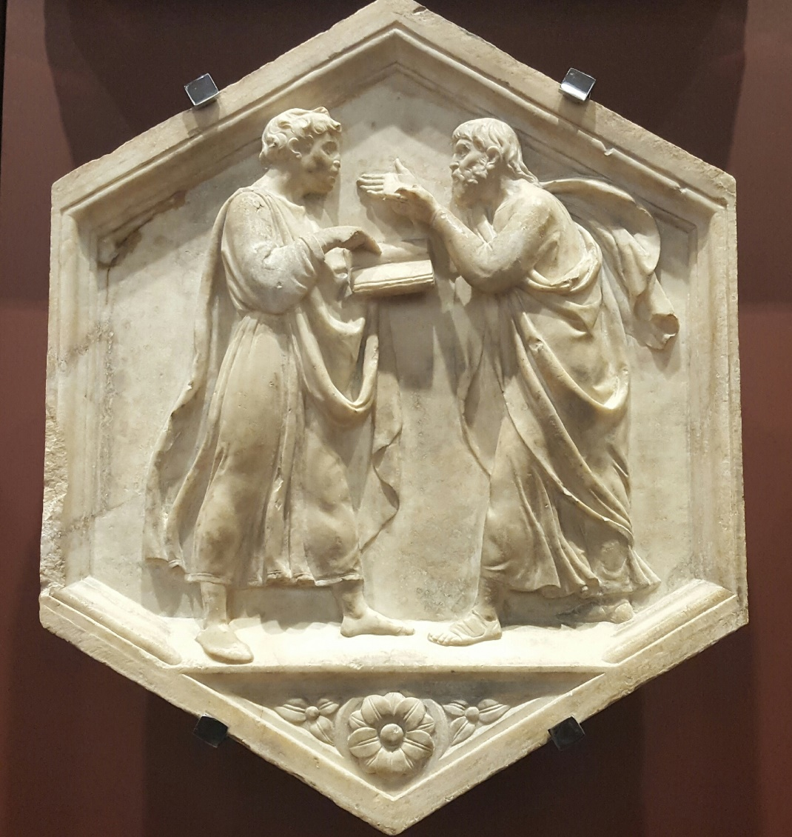
Examples of argumentation
Plato and Aristotle: dialectics.
Luca della Robbia
1437 - 1439

Slide 13
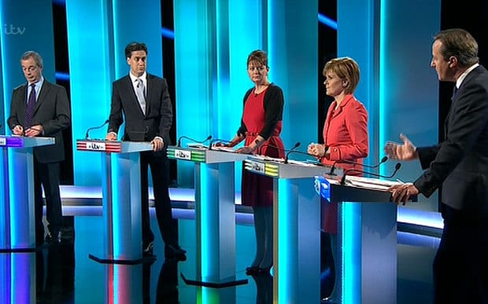
Examples of argumentation
Leaders’ Debate, UK General Election 2015 (ITV/REX)

Slide 14

Examples of argumentation

Slide 15
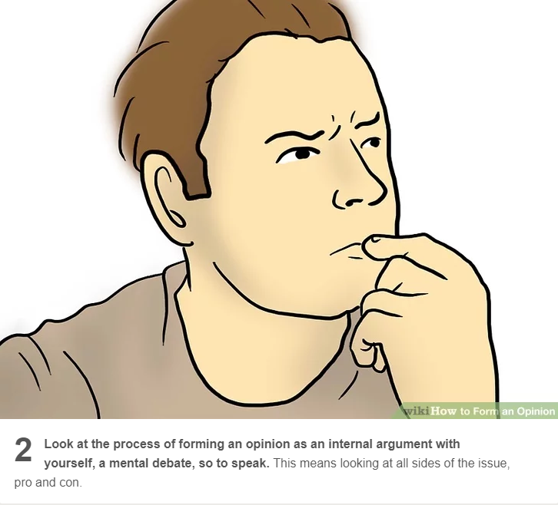
Examples of argumentation
https://www.wikihow.com/Form-an-Opinion

Slide 16
Why do we want machines that can argue?
Argumentation theory allows us to deal with incomplete, uncertain, inconsistent knowledge, conflicting opinions, expressed in different media and formats – all typical of the real world.
Argumentation theory is inherently suited to providing explanations, and supports interactions between:
* People and machines (where humans can challenge, question, and input into the machine’s reasoning)
* Machines and machines (M2M Communications).
Computational argumentation began in the 1980s, as researchers in the first wave of successful AI (Expert Systems) sought to provide explanations for automated decision systems (what is now called XAI).

Slide 17
Argumentation Theory
Argumentation theory is concerned with acceptability conditions for arguments in relation to other arguments.
For example (Example 1):
a1 We should go to the park for a picnic, that’s cheap and I don’t have much money at the moment.
a2 But I’m cold today, we should go to the café instead.
a3 You won’t be cold this afternoon, the forecast says it’s going to be really hot.
Arguments can attack one another.

Slide 18
Attack relations: Example 1
a1 We should go to the park for a picnic, that will be the cheapest option.
a2 But I’m cold today, we should go to the café instead.
a3 You won’t be cold this afternoon, the forecast says it’s going to be really hot.
a1
a2
a3

Slide 19


Attack relations
a1 We should go to the park for a picnic, that will be the cheapest option.
a2 But I’m cold today, we should go to the cafe instead.
a3 You won’t be cold this afternoon, the forecast says it’s going to be really hot.
a1
a2
a3
Which arguments are not attacked?
Which arguments defend themselves with a counter-attack?

Slide 20
Approaches to argumentation
Argumentation can be formally studied from different angles.
As a dialogue mechanism.
By considering the structure of arguments and how this affects the attack relation between them.
From an abstract point of view. We assume that an attack relation is given and we want to reason about what it is reasonable to conclude.
In this lecture, we will focus on abstract argumentation.

Slide 21
Abstract argumentation
Abstract argumentation disregards the internal structure of arguments and focusses instead on acceptability conditions that allow certain sets of arguments to co-exist in a rational manner.
Founding research paper:
P. M. Dung [1995]:
“On the acceptability of arguments and its fundamental role in non-monotonic reasoning, logic programming and n-person games.”
Artificial Intelligence Journal, 77: 321—357.

Slide 22
Abstract argumentation
a1 We should go to the park for a picnic, that will be the cheapest option.
a2 But I’m cold today, we should go to the cafe instead.
a3 You won’t be cold this afternoon, the forecast says it’s going to be really hot.
a1
a2
a3
This is an abstract representation of the arguments above and the attacks between them.

Slide 23
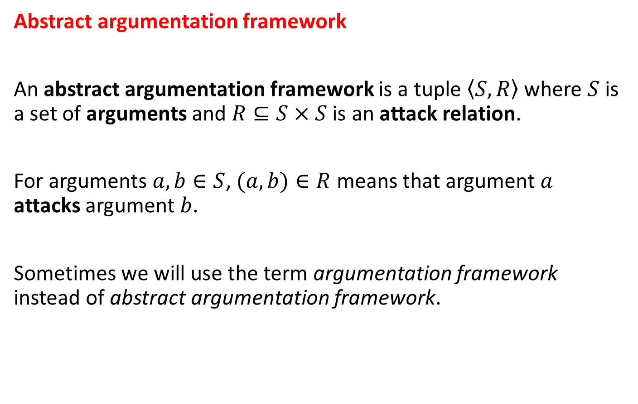
Abstract argumentation
Abstract argumentation framework
An abstract argumentation framework is a tuple $\left\langle S, \left.R\right\rangle \right.$ where $S$ is a set of arguments and $R⊆S×S$ is an attack relation.
For arguments $a, b∈S$, $(a, b)∈R$ means that argument $a$ attacks argument $b$.
Sometimes we will use the term argumentation framework instead of abstract argumentation framework.

Slide 24
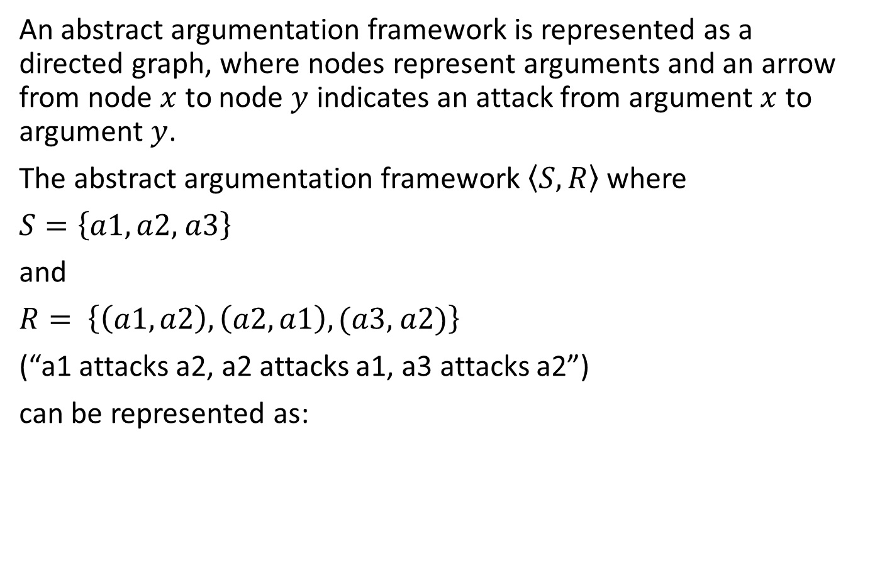
Abstract argumentation frameworks
An abstract argumentation framework is represented as a directed graph, where nodes represent arguments and an arrow from node $x$ to node $y$ indicates an attack from argument $x$ to argument $y$.
The abstract argumentation framework $\left\langle S, \left.R\right\rangle \right.$ where
$S=\left\{a1, a2, \right.\left.a3\right\}$
and
$R= \left\{\left(a1, a2\right), \left(a2, a1\right), (a3, \right.\left.a2)\right\}$
(“a1 attacks a2, a2 attacks a1, a3 attacks a2”)
can be represented as:
a1
a2
a3

Slide 25
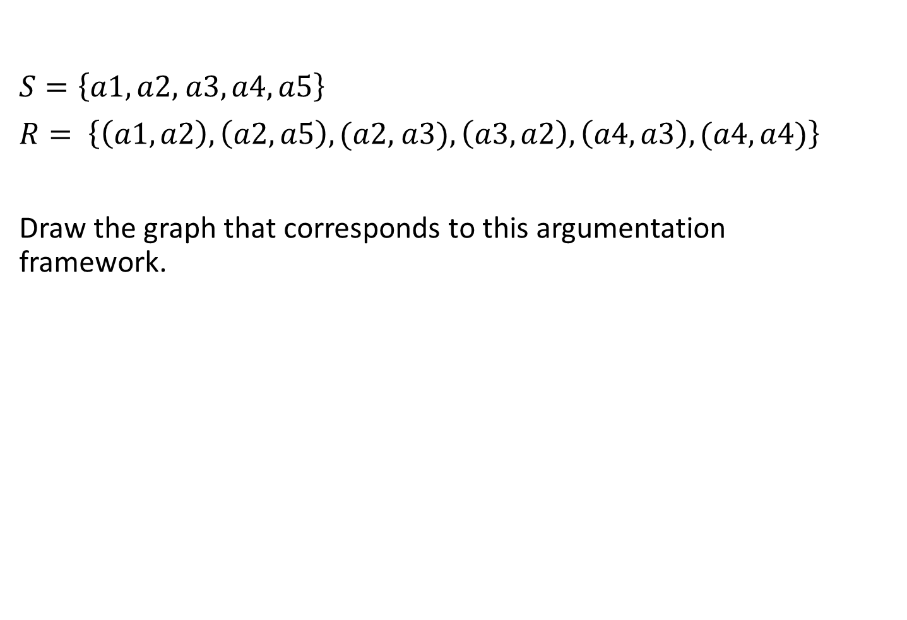
Another example: Example 2
$S=\left\{a1, a2, \right.\left.a3, a4, a5\right\}$
$R= \left\{\left(a1, a2\right), \left(a2, a5\right), (a2, \right.\left.a3), \left(a3, a2\right), \left(a4, a3\right), (a4, a4)\right\}$
Draw the graph that corresponds to this argumentation framework.

Slide 26
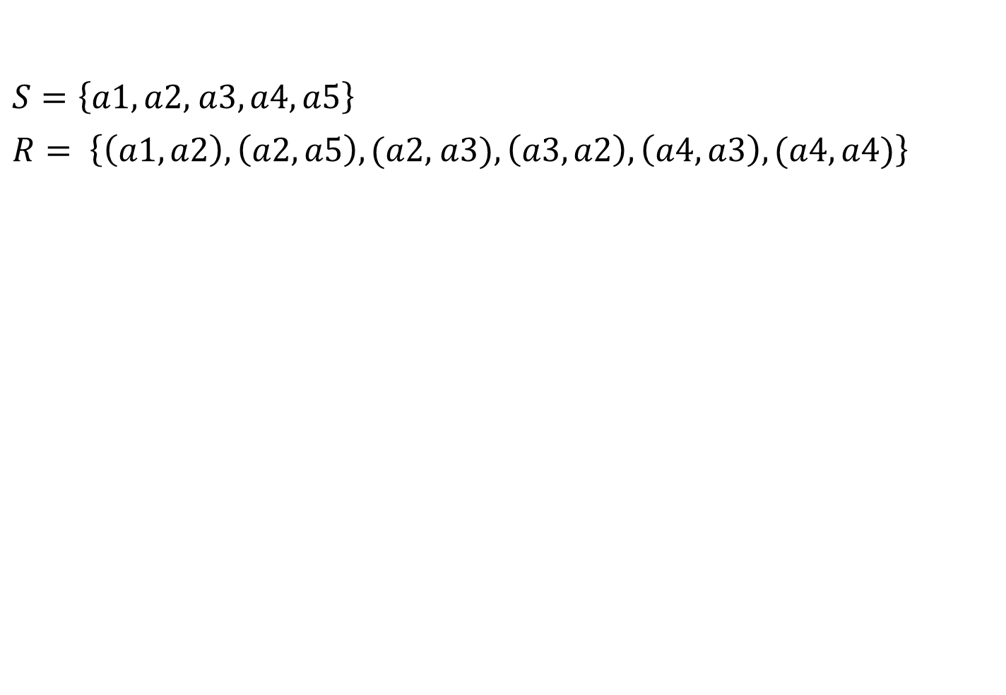
Example 2 continued
$S=\left\{a1, a2, \right.\left.a3, a4, a5\right\}$
$R= \left\{\left(a1, a2\right), \left(a2, a5\right), (a2, \right.\left.a3), \left(a3, a2\right), \left(a4, a3\right), (a4, a4)\right\}$
a5
a2
a3
a4
a1

Slide 27
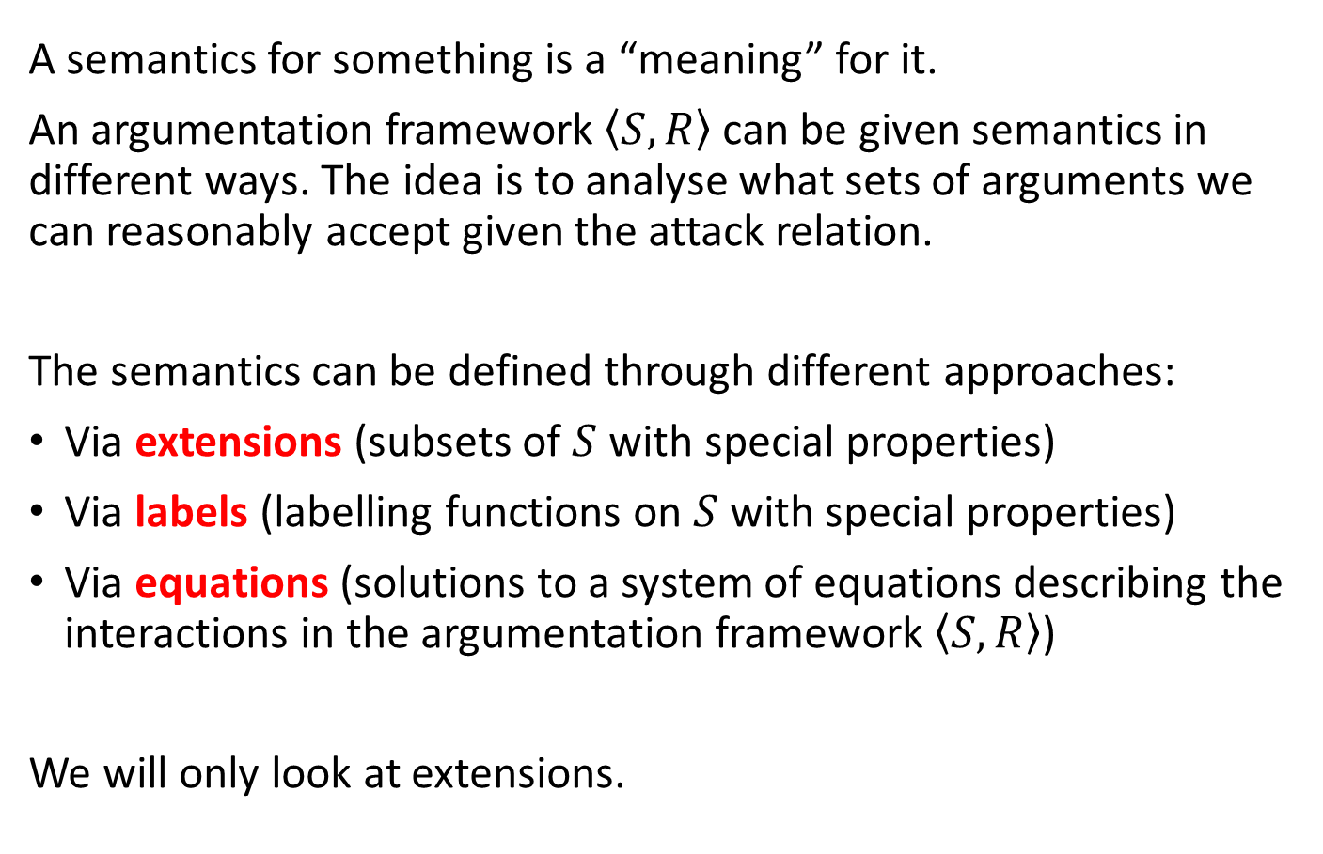
Argumentation semantics
A semantics for something is a “meaning” for it.
An argumentation framework $\left\langle S, \left.R\right\rangle \right.$ can be given semantics in different ways. The idea is to analyse what sets of arguments we can reasonably accept given the attack relation.
The semantics can be defined through different approaches:
Via extensions (subsets of $S$ with special properties)
Via labels (labelling functions on $S$ with special properties)
Via equations (solutions to a system of equations describing the interactions in the argumentation framework $\left\langle S, \left.R\right\rangle \right.$)
We will only look at extensions.

Slide 28
Extension-based semantics
A subset of the set of arguments with special properties is defined as:
An extension is a set of arguments that are jointly “acceptable”.
Arguments are justified according to their status in these extensions.
The basic intuition here is that we can have a subset of arguments which jointly support (or defend) one another.
- eg, All the arguments on one side of a debate
(for instance: The PRO arguments or the CON arguments).

Slide 29
Extension-based semantics
A subset of the set of arguments with special properties is defined as:
An extension is a set of arguments that are jointly “acceptable”
Arguments are justified according to their status in these extensions.
Consider Example 1:
a1
a2
a3

Slide 30
Jointly acceptable arguments:
a1 We should go to the park for a picnic, that will be the cheapest option.
a2 But I’m cold today, we should go to the cafe instead.
a3 You won’t be cold this afternoon, the forecast says it’s going to be really hot.
We might consider the set comprising the two arguments {a1, a3} as jointly acceptable.
a1
a2
a3

Slide 31
Extension-based semantics
A subset of the set of arguments with special properties is defined as:
An extension is a set of arguments that are jointly “acceptable”.
Arguments are justified according to their status in these extensions.
Before we can formally introduce extensions, we need to present some concepts.

Slide 32
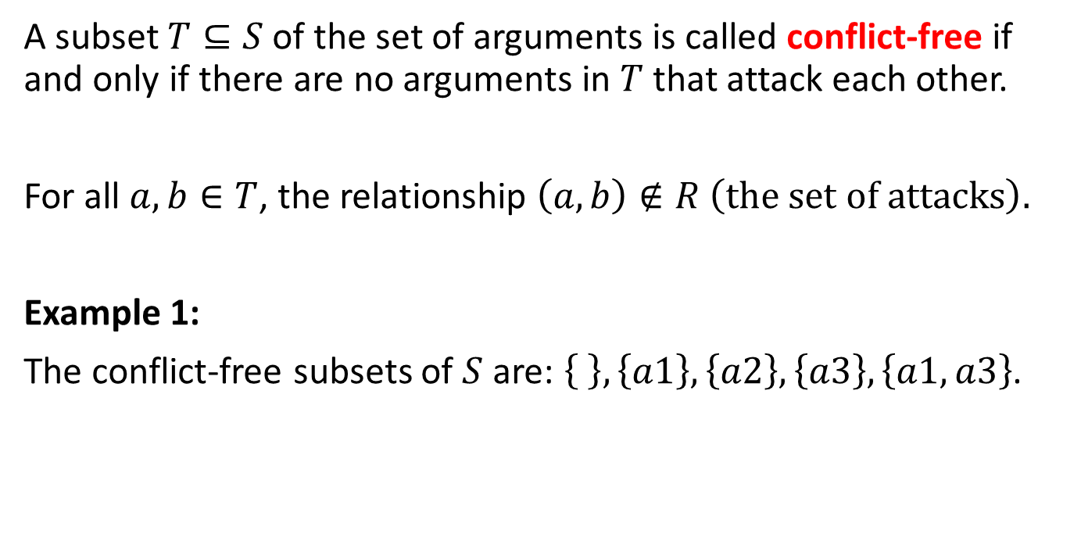
Conflict-free subsets
A subset $T⊆S$ of the set of arguments is called conflict-free if and only if there are no arguments in $T$ that attack each other.
For all $a, b∈T$, the relationship $\left(a, b\right)∉R \left(the set of attacks\right).$
Example 1:
The conflict-free subsets of $S$ are: $\left\{ \right\}, \left\{a1\right\},\left\{a2\right\},\left\{a3\right\},\left\{a1, a3\right\}$.
a1
a2
a3

Slide 33
Exercise 1: Which subsets are conflict-free?
$S=\left\{a1, a2, \right.\left.a3, a4, a5\right\}$
$R= \left\{\left(a1, a2\right), \left(a2, a5\right), (a2, \right.\left.a3), \left(a3, a2\right), \left(a4, a3\right), (a4, a4)\right\}$
a5
a2
a3
a4
a1

Slide 34
Pause the presentation while you do this Exercise: Which subsets are conflict-free?
$S=\left\{a1, a2, \right.\left.a3, a4, a5\right\}$
$R= \left\{\left(a1, a2\right), \left(a2, a5\right), (a2, \right.\left.a3), \left(a3, a2\right), \left(a4, a3\right), (a4, a4)\right\}$
a5
a2
a3
a4
a1
Hint: You need to check every possible subset of S.
There are 2^5 subsets = 32 subsets to check.

Slide 35
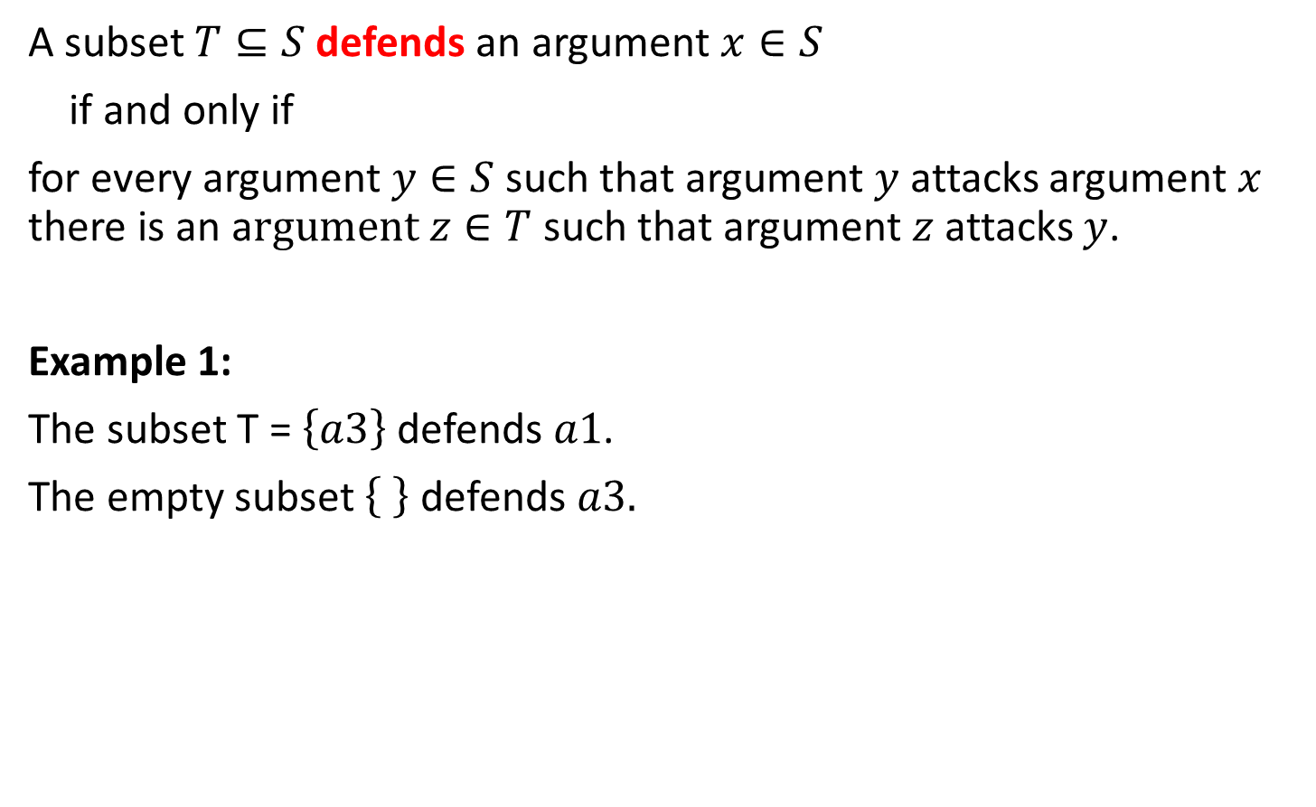
Argument defence
A subset $T⊆S$ defends an argument $x∈S$
if and only if
for every argument $y∈S$ such that argument $y$ attacks argument $x$ there is an a$rgument z∈T$ such that argument $z$ attacks $y$.
Example 1:
The subset T = $\left\{a3\right\}$ defends $a1$.
The empty subset defends $a3.$
a1
a2
a3

Slide 36
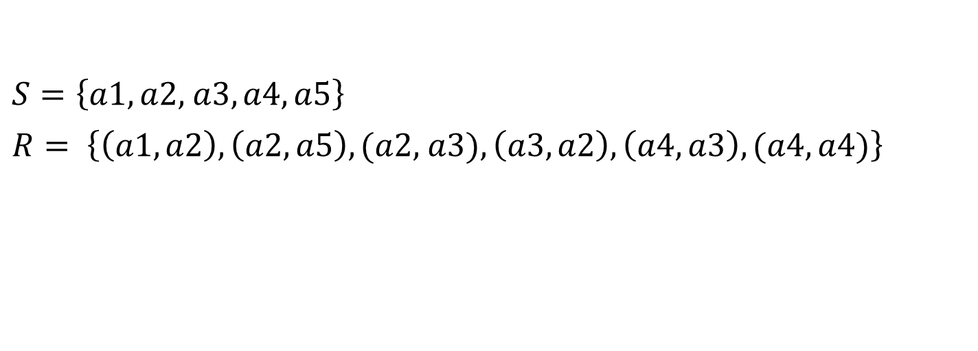
Exercise 2: Which subsets defend each argument?
$S=\left\{a1, a2, \right.\left.a3, a4, a5\right\}$
$R= \left\{\left(a1, a2\right), \left(a2, a5\right), (a2, \right.\left.a3), \left(a3, a2\right), \left(a4, a3\right), (a4, a4)\right\}$
a5
a2
a3
a4
a1

Slide 37
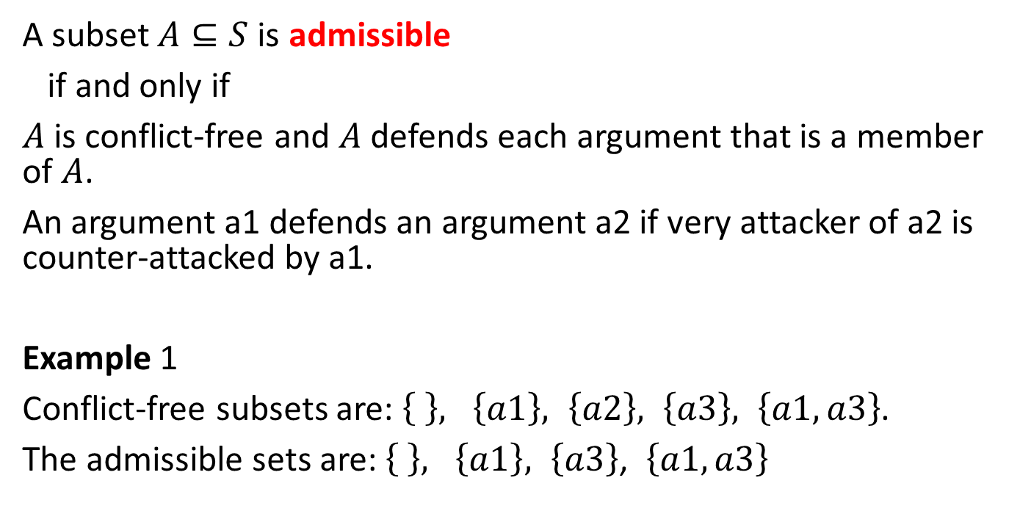
Admissible subsets
A subset $A⊆S$ is admissible
if and only if
$A$ is conflict-free and $A$ defends each argument that is a member of $A$.
An argument a1 defends an argument a2 if very attacker of a2 is counter-attacked by a1.
Example 1
Conflict-free subsets are: $\left\{ \right\}, \left\{a1\right\}, \left\{a2\right\}, \left\{a3\right\}, \left\{a1, a3\right\}$.
The admissible sets are:$\left\{ \right\}, \left\{a1\right\}, \left\{a3\right\}$, $\left\{a1, a3\right\}$
a1
a2
a3

Slide 38
Exercise 3: Which subsets are admissable sets?
$S=\left\{a1, a2, \right.\left.a3, a4, a5\right\}$
$R= \left\{\left(a1, a2\right), \left(a2, a5\right), (a2, \right.\left.a3), \left(a3, a2\right), \left(a4, a3\right), (a4, a4)\right\}$
a5
a2
a3
a4
a1

Slide 39
End of Part A
The lectures for Week 8 continue with Part B.

